Slide 1
CLFP 2020 Projected Net Revenue Requirement
Meeting
October 21, 2019 10:00 AM MDT
Black Hills Energy
7001 Mt Rushmore Rd
Rapid City, SD 57702

Slide 2
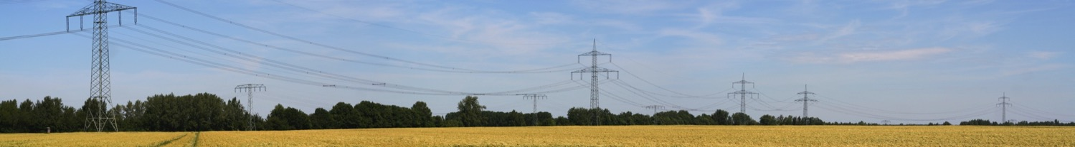
Agenda
Introductions
CLFP Transmission System Overview
Cheyenne Light, Fuel and Power Formula Rate Protocols Update
Discuss the 2020 Projected Net Revenue Requirement
Where to Find Information and be Engaged
Questions & Comments

Slide 3
Cheyenne Transmission System (CLPT)

Slide 4
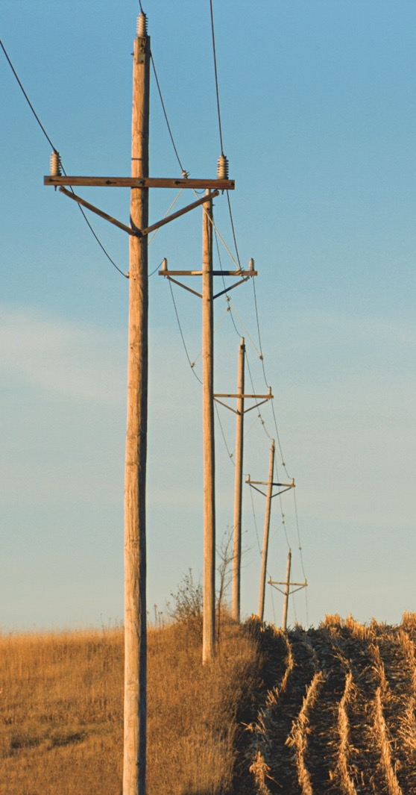
Formula Rate Protocols
FERC filing ER19-697 allowed Cheyenne to update its Attachment H Tariff rates and Schedule 1 rates being retroactively effective to January 1,
At the conclusion of any additional proceedings, appropriate updated information will be provided.

Slide 5

Summary of Key Drivers
The CLPT 2020 total projected rate base increases $3,664,818 or 10.17% over the 2019 estimate.
The 2020 projected annual rate is $28.18 kW-Yr, an increase of $8.34 kW-Yr over 2019 estimate.
Primary Drivers of Increase
    Capital Additions:
      2019 - $4,440,551
      2020 - $9,922,301
    Increase in O&M Expenses:
      Increase in allocated expenses and labor costs $390,506
      Growth is due to increase in actual and projected net plant in Service - $393,631(Projected O&M and A&G expenses are calculated using the
    projected net plant in Service YoY increase ratio).
    Increase in Taxes Other than Income:
      Growth is due to increase in actual and projected net plant in Service - $106,284.
      An error on 2018 FERC Form 1 included total balances instead of using only electric TOTI balances, this will be corrected in the CLPT 2020 True Up - $143,436.

Slide 6
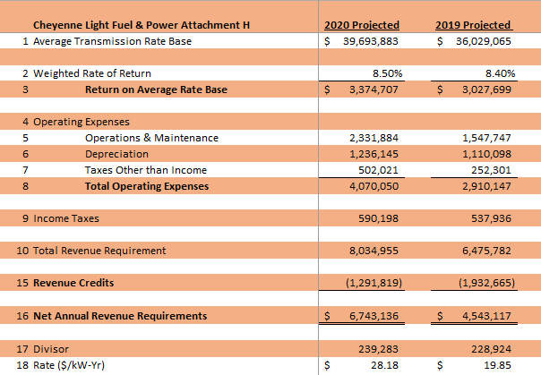
2020 Projected Revenue Requirement

Slide 7

How to be Engaged
We invite our transmission customers to sign up to receive notices related to the Projected Net Revenue Requirement and Annual True-Up. A notification will be sent by email whenever there is an update. These notifications are also posted on our OASIS site. https://www.oasis.oati.com/CLPT/index.html
To sign up for the notices go to our website www.blackhillsenergy.com. On the top left click on 3 orange lines then Our company. Next under FERC & Transmission Rates click on Learn More then under Cheyenne Light, Fuel and Power click on Learn More. At the top click on Sign up for notices. Key in your email address, name and click Subscribe.
If you have any questions please contact us on our transmission line at 605-721-2220 or email Transmissionservice@blackhillscorp.com.

Slide 8
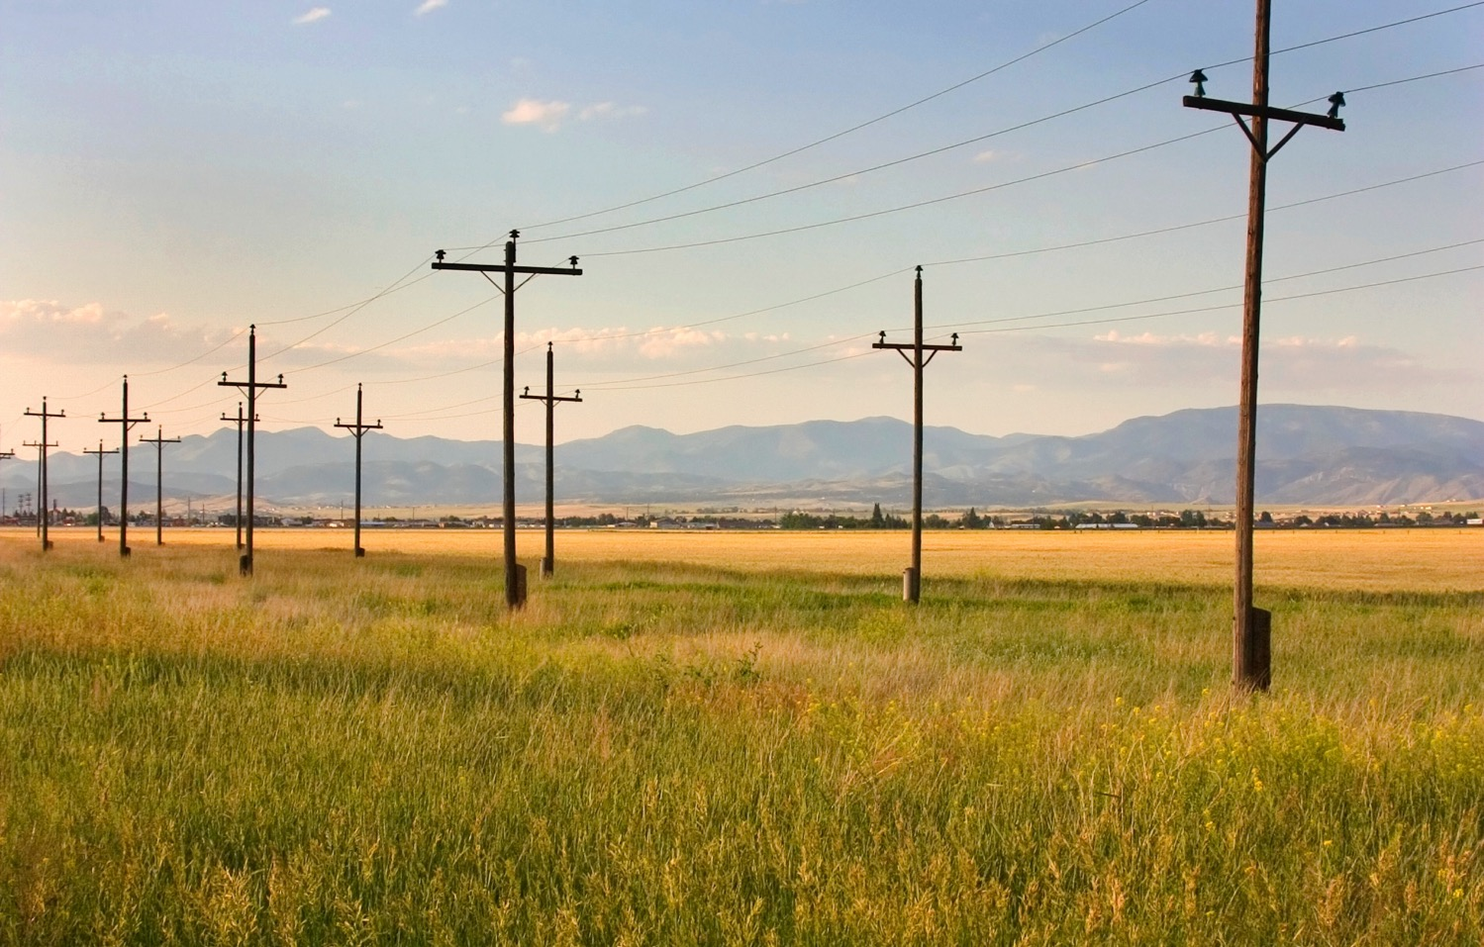
Questions

Slide 9

Comments / Suggestions
Eric East
Manager Tariff & Contract Administration
Transmissionservice@blackhillscorp.com
(605) 721-2200
Jacki Welbig-Stenson
Electric Transmission System Analyst
Jacki.WelbigStenson@blackhillscorp.com
(605) 721-2310

